Slide 1
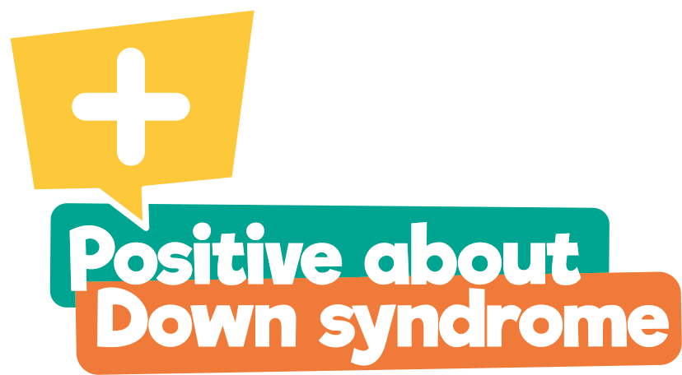
This presentation has been created by Down syndrome UK, registered charity number 1184564
It is available for general use but would ask that if a school has a member(s) who has/have Down syndrome, or there are close relatives of a young person with Down syndrome,
that you seek permission of the Parents/Carers first.
PADS has created the initiative Dress Up For Down syndrome to encourage parents, staff and children to dress up and celebrate Down syndrome Awareness month during October!
Do please share your images #DU4DS
We hope you find this presentation informative and insightful
We would welcome your feedback: info@positiveaboutdownsyndrome.co.uk
Please note that this presentation contains links to YouTube
So please ensure you can access beforehand

Slide 2
Primary Assembly Presentation
Celebrating Down syndrome!

Slide 3
Imagine how strange it would be if you came to school one morning and everyone looked exactly the same – like robots or Enderman from ‘Minecraft’. You wouldn’t be able to tell who your friends were and who was your teacher.

Slide 4
Luckily, each one of us is different;
we are unique, even if we look a little like a brother or sister, or share likes and dislikes with our friends.

Slide 5
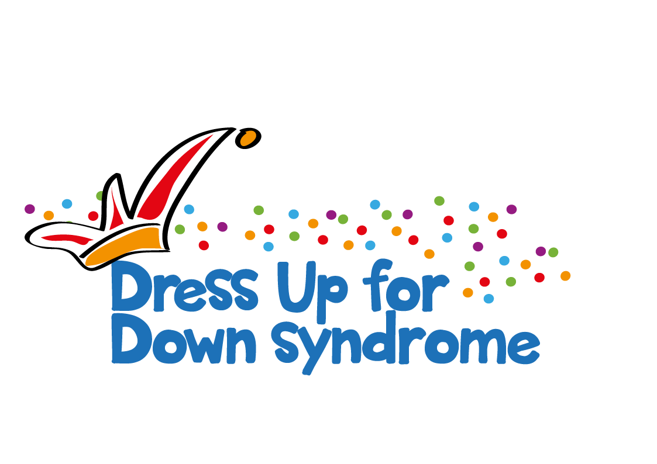
How we celebrate Down Syndrome Awareness
World Down Syndrome Day (WDSD) is held on the
21st March every year.
And October is Down syndrome Awareness month.
People all over the world take part doing fun activities and we are taking part too with Dress Up for Down Syndrome!
It gives us the opportunity to learn about Down syndrome and how to make sure we include people with
Down syndrome.

Slide 6
What is Down syndrome?
Babies are born with Down syndrome and will always have it.

Slide 7
Down syndrome is not an illness.
You cannot catch it like a cold.

Slide 8
Children with Down syndrome share some physical characteristics...
but look more like their families than each other.

Slide 9
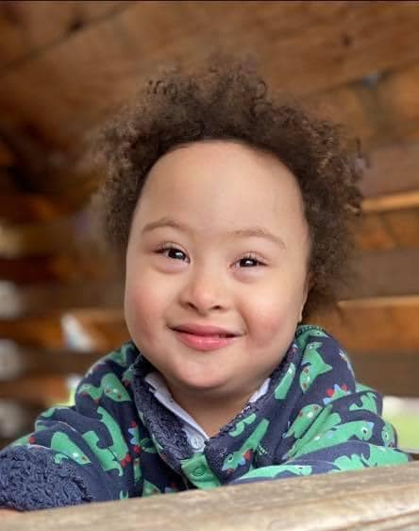
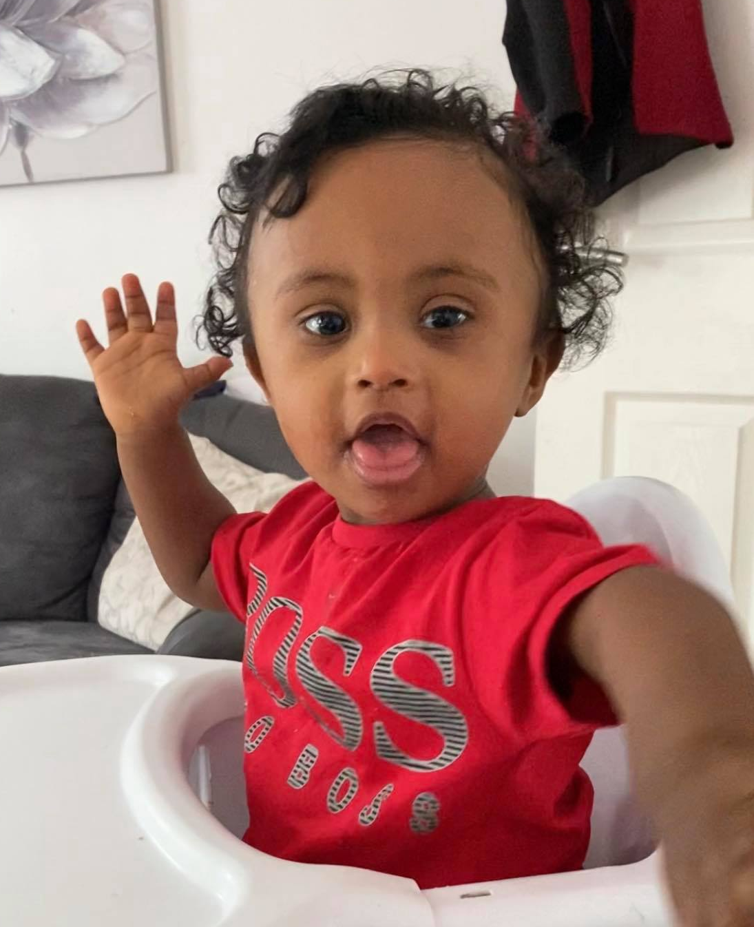
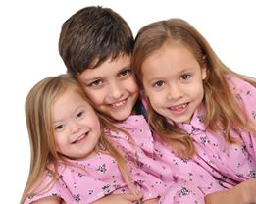
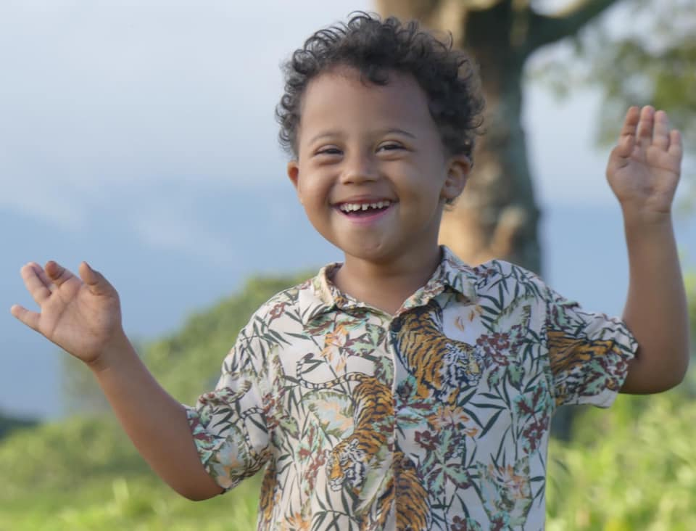
There are people with Down syndrome all over the world.

Slide 10
What causes
Down Syndrome?
Chromosomes!
These are tiny thread-like structures inside our cells.
Everyone has them, in fact most people have 23 pairs (46 altogether) in every cell and we have a lot of cells!

Slide 11
Chromo - what? …Chromosomes!
These chromosomes are important as they decide if we will be male or female, what we look like and lots of other really important things.
A person with Down syndrome is born with an extra chromosome in every cell.
So, instead of 46 individual chromosomes (23 pairs),
they have 47.

Slide 12
Children with Down syndrome…
go to school
like watching TV
have friends
love to play
have feelings
and are just like you!

Slide 13
Finding some things tricky
Having Down syndrome means that you can find things like speaking, remembering and understanding more difficult.
Children with Down syndrome will learn to read and write, it might take them longer and be harder work for them.

Slide 14
Just Like You-Down Syndrome - YouTube

Slide 15
Just like you
They say that I have extra needs,
and while that’s partly true,
the needs that matter most to me
are the same ones you have too.
I need to be accepted.
I need friends that make me smile.
I need a chance to learn and grow,
feeling valued all the while.
Sure, I need some extra help
and just like you, some things I can’t do
but I hope you’ll see beyond all that
INSIDE I AM JUST LIKE YOU…..

Slide 16
THE HIRING CHAIN performed by STING
https://youtu.be/SKku4RAWa4M

Slide 17
Reflection - More alike then different
Are you the same as the person next to you?
Everyone in this room is different from each other
Everyone in the world is different from each other
When a person has Down syndrome, it is just one small part of who they are
Being a good friend to someone else is the same no matter who they are.

Slide 18
